Slide 1
Drug & Alcohol Testing: Regulatory Violations to Avoid!
IPTA Spring 2016 Regional Meetings
Chris Darling, IPTA Executive Director
Special “Thank You” to Terry Voy with the Iowa Association of School Boards for providing updated information for this presentation.

Slide 2
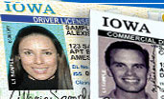
Who is subject to drug & Alcohol Testing?
Employees who operate a commercial
motor vehicle including:
Vehicle designed for more than 15 passengers
Carries a manufacturer’s GVWR of 26,001 pounds or greater
Operators Must Possess a Commercial Driver’s License
IOWA DRUG & ALCOHOL TESTING PROGRAM (IDAPT) (Sponsored by: Iowa Association of School Boards)

Slide 3
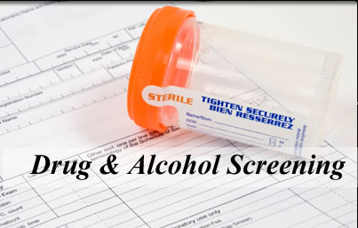
Part 382, Subpart C Types of Testing Required:
● Pre-Employment (Drug only)
● Post-accident
● Random
● Reasonable Suspicion
● Return-to-duty
● Follow-up

Slide 4
Employee Education & Training
You must provide information including:
Name of district contact for program information
Prohibited conduct
Requirement that employees must be tested for drugs and alcohol
When & under what circumstances that employees will be tested
Testing procedures
Explanation of what constitutes a refusal to test
Consequences of refusing a test
Effects of drugs and alcohol on a person’s health, work and personal life.
How to access individuals or organizations that provide counseling and access to treatment programs

Slide 5
§382.107 – Do You Know Your DER?
Designated Employer Representative
The DER - an individual selected by the employer to administer the employer’s drug and alcohol testing program.
The DER - must be an employee of the company (school district).
The DER - must have knowledge of Federal regulations related to drug and alcohol testing.
The DER - receives communications from service agents including the list of drivers selected for random testing.
The DER - sees that drivers selected for random testing are notified in accordance with the regulations.
The DER - is authorized to take immediate actions to remove employees from safety-sensitive duties resulting from testing violations and to make required decisions in the testing and evaluation processes

Slide 6
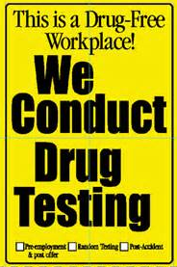
§382.301, Pre-employment
• Must have an initial, negative drug-only test result before allowing a new employee to operate a commercial motor vehicle.
NOTE: Includes new-hires and existing employees that are changing positions to include operating a commercial motor vehicle.

Slide 7
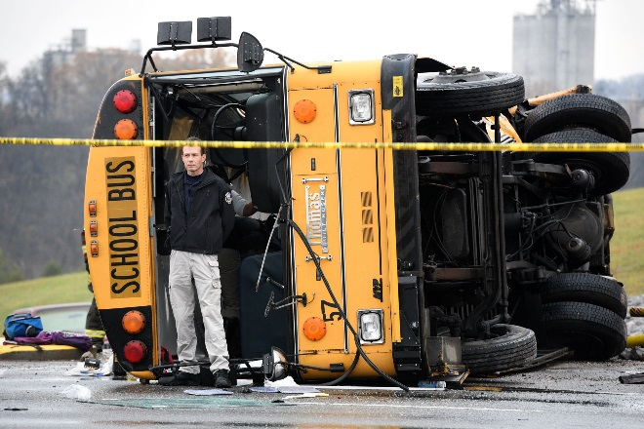
§382.303 - Post-Accident Test
Any fatality involved – must test your driver for drugs & alcohol.
No fatality and your driver is not issued a citation – No drug or alcohol test required.
Driver issued citation and one of the following occurred – drug & alcohol test required.
INJURY with Immediate Treatment Away from the Scene
TOWED VEHICLE due to Disabling Damage
IMPORTANT: Required testing must be completed
(Alcohol) - within 2 hours of the accident or a maximum of 8 hours after which attempts to test stop.
(Drug Test) – within 32 hours of the accident after which attempts to test stop.
Note: If unable to test within required time periods, you must document why it was not possible to test
within the required time.

Slide 8
§382.305 Random
* Drugs = 50% of driving positions (Pool)
Alcohol = 10% of driving positions (Pool)
In addition:
● Testing is unannounced
● Spread reasonably throughout the calendar year
● Each driver has an equal chance of being tested at time of selection
* NOTE: On January 1, 2016, the USDOT set the minimum drug test rate to 25% of driver pool. IDATP will continue drug testing at the 50% rate for 2016.

Slide 9
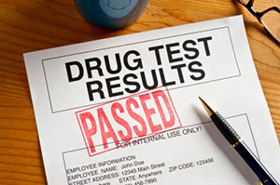
§382.305, Random
● Each driver selected – must be tested during the selection period (IDATP Quarterly)
● Must proceed immediately to test site
(Note: Immediately means that after notification, all employee actions must lead to an immediate specimen collection.)
● Alcohol - Just before, just after, or while performing safety- sensitive function

Slide 10
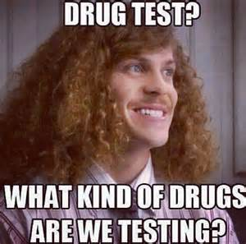
§382.307, Reasonable Suspicion
● Supervisors must be trained to recognize signs (Iowa Association of School Boards, IASB online training available)
● Observations must be specific, timely and articulable
● Based on driver’s appearance, behavior, speech or body odor
● A written record of observations made is required to be maintained on file.
Document, Document, Document
(Recommendation - a second trained observer should be consulted to confirm suspected violation.)

Slide 11
§382.309, Return-to-duty Testing
● Only after evaluation by a Substance Abuse
Professional (SAP) and treatment
● Must be authorized by the SAP
● Must have negative test result before resuming safety-sensitive functions
(Important note: Returning driver to duty is based on district policy or bargaining agreement.)

Slide 12
§382.311, Follow-up
● Follow-up testing MUST be performed in accordance with 49 CFR part 40, Subpart O
● Number of tests are specified by the Substance Abuse Professional (SAP)
● A minimum of 6 in first 12 months
● Scheduled and unannounced by employer
● Testing is in addition to regular random testing
NOTE: Cost of additional testing is the responsibility of driver or school policy.

Slide 13
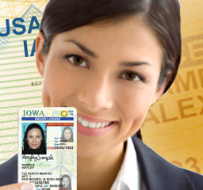
Prohibitions
May not use or possess alcohol or prohibited drugs prior to or during the performance of safety sensitive function (medications may be authorized by medical practitioner)
May not report for service or remain on duty if you:
consume alcohol 4-hrs prior to reporting for duty
BAC test result of .02-.039 (24 hours out of serv.)
.04 or greater = positive test
May not refuse a required drug or alcohol test
Adulteration or substitution of specimen = refusal
Positive drug or alcohol test – referred to certified SAP
(Substance Abuse Professional)

Slide 14
Critical Program Procedures
Post accident test determination (when/when not to test)
Non-DOT Testing (not allowed by DOT & not covered by IDATP)
Driver notification procedure
Non-prescribed meds is a DOT violation treated same as a “positive” test (using family member meds)
Refusal/failure to test
Leaving collection site w/o testing = failure to test
Driver information & supervisor training – required
Alternate List Use

Slide 15
Drug and Alcohol Testing Brochure for Drivers
www.fmcsa.dot.gov/
rules-regulations/topics/drug/drug.htm

Slide 16
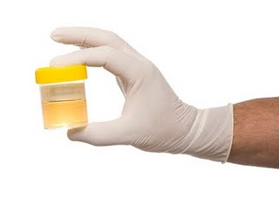
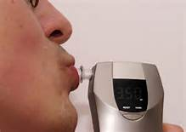
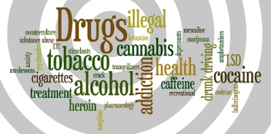
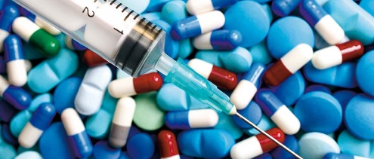
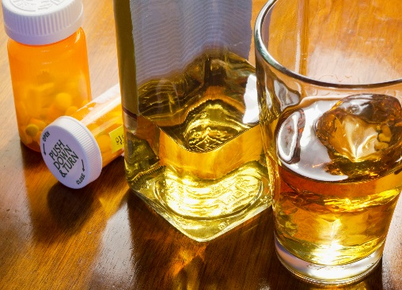
Questions?

Slide 17
Thank you!
Keep the focus clearly on the safety of all children riding on your communities School Buses!
Stay Clean
Stay Sober
Stay Safe

